Slide 1
GoFundMe
&
The Great Success of Privatized Healthcare

Slide 2
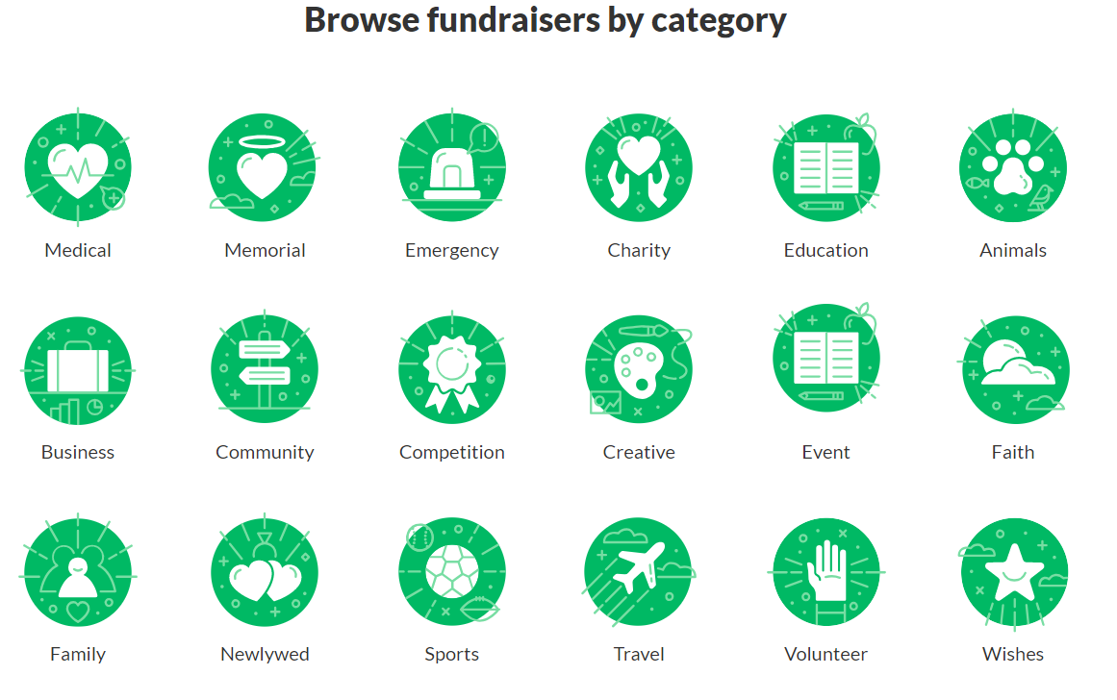
Website Structure
https://www.gofundme.com/discover

Slide 3
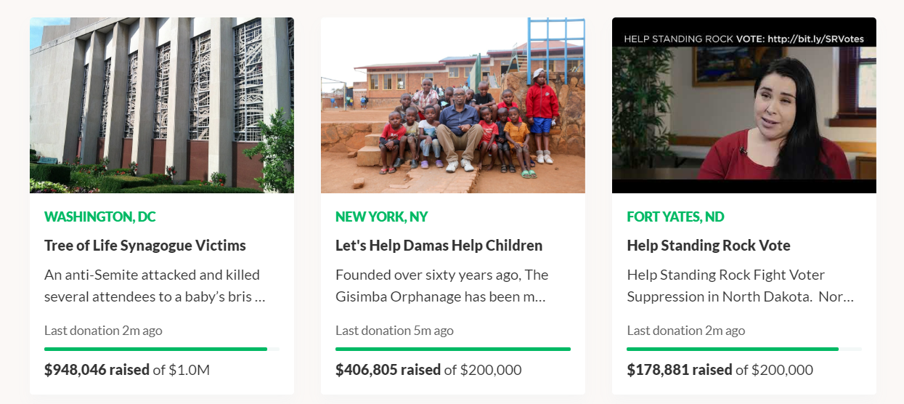
Website Structure
https://www.gofundme.com/discover/<insert category>

Slide 4
Website Structure
https://www.gofundme.com/tree-of-life-synagogue-shooting

Slide 5
Hypothesis
Funding campaigns within social welfare categories (e.g. Charity, Emergencies, Medical) will have significantly different performance from ‘trivial’ categories.

Slide 6
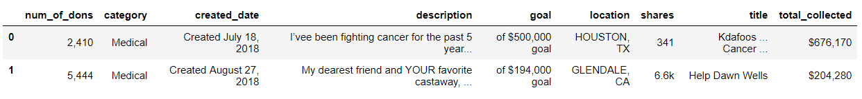
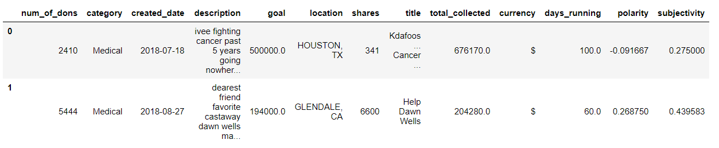
Data Cleaning
Raw Data from Scrape:
----------------------------------------------------------------------Becomes---------------------------------------------------------------------
Clean Data w/ new features:

Slide 7
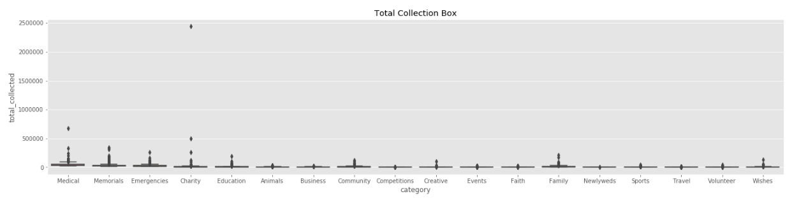
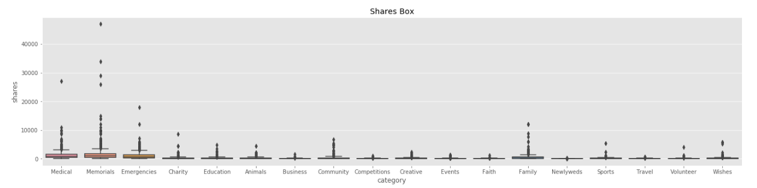
EDA – Skewed Variables

Slide 8
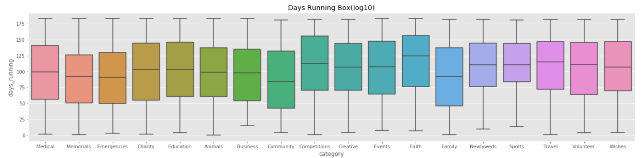
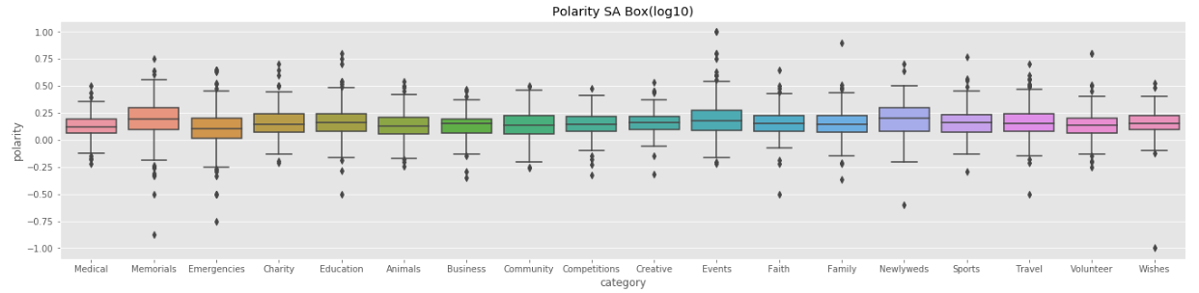
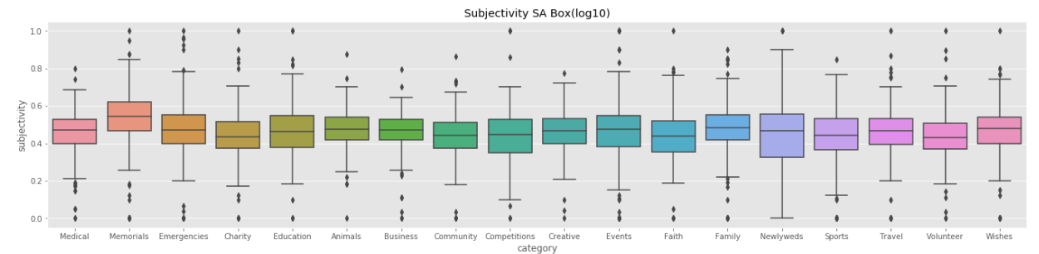
EDA – Normal Variables

Slide 9
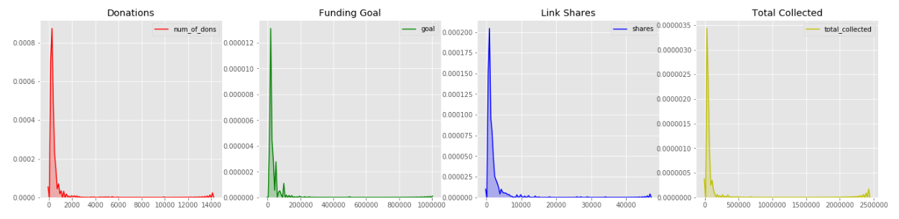
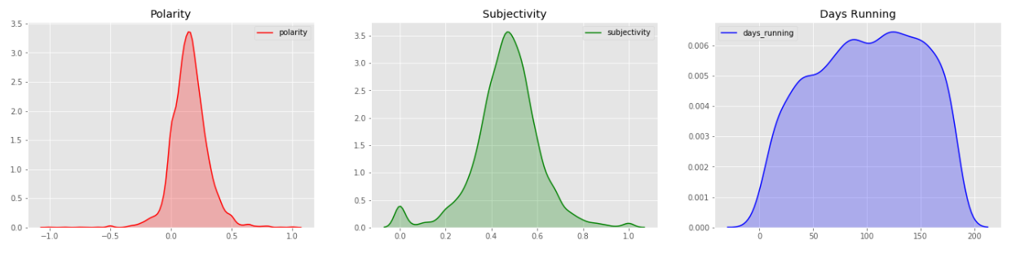
EDA - All

Slide 10
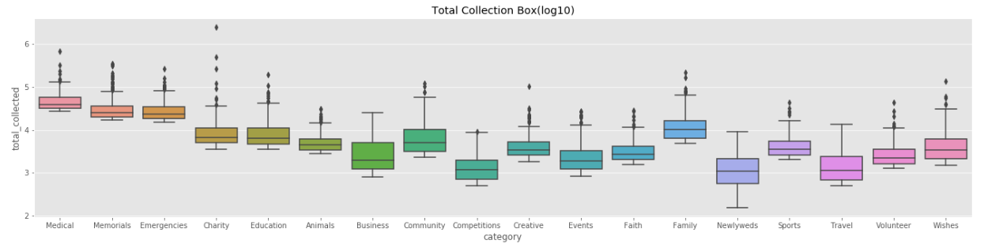
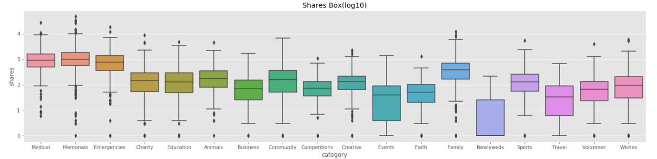
EDA
Handling Skewed Data – Convert to log10 scale

Slide 11
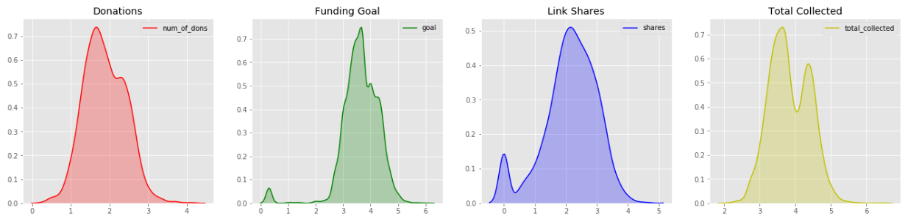
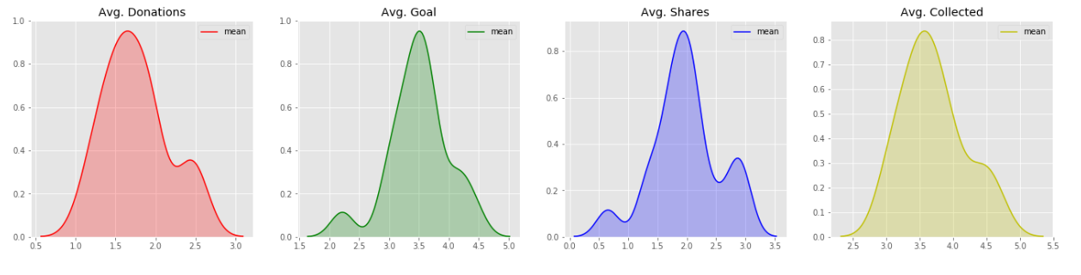
EDA
Handling Skewed Data – Convert to log10 scale

Slide 12
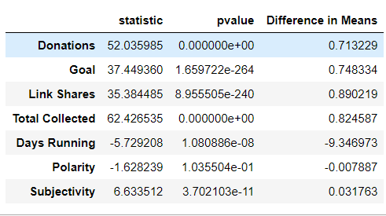
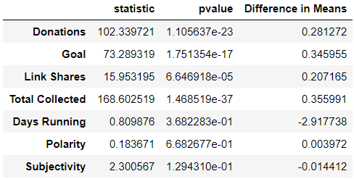
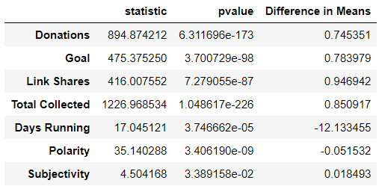
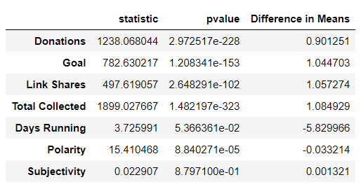
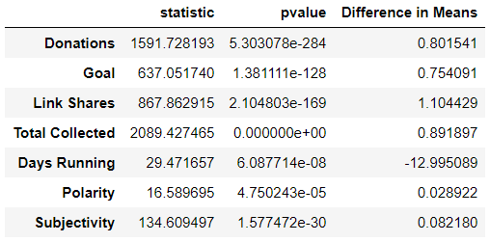
T-Tests
4 - Categories
Charity, Emergencies, Medical, Memorial
1 – Category
Charity
Emergencies
Medical
Memorial

Slide 13
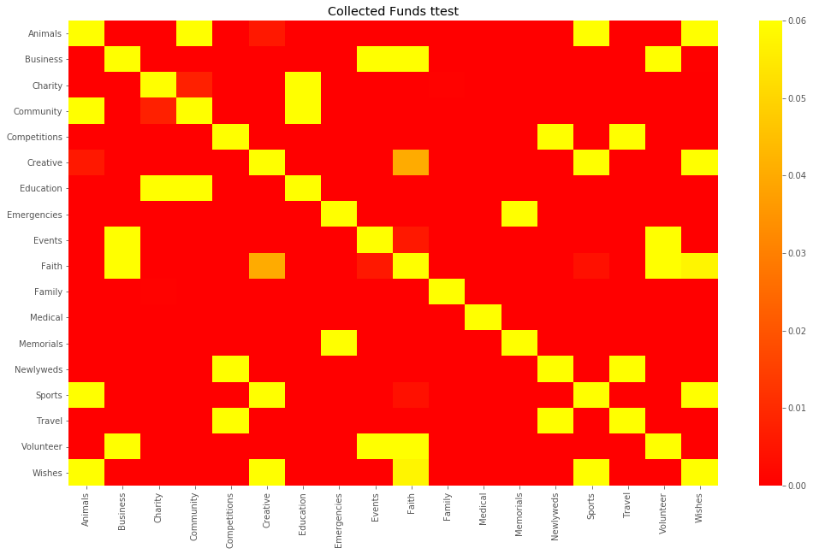
Pairwise T-Test

Slide 14
Going Further…
- Find data on completed funding campaigns to incorporate ML
- Expand scope of scrape to incorporate and filter more categoricals (comments, FB interactions)
- Granular data on donation amounts/dates
- Granular categories (prevent crossover of campaign types)
- More rigorous approach to NLP/Sentiment Analysis

